Slide 1
CS118 – Programming Fundamentals
Lecture # 07
Saturday, September 14, 2019
FALL 2019
FAST – NUCES, Faisalabad Campus
Course Instructor:
Ebad Majeed
Slides Credit:
Rizwan Ul Haq

Slide 2
Basic Components of C++ Program

Slide 3
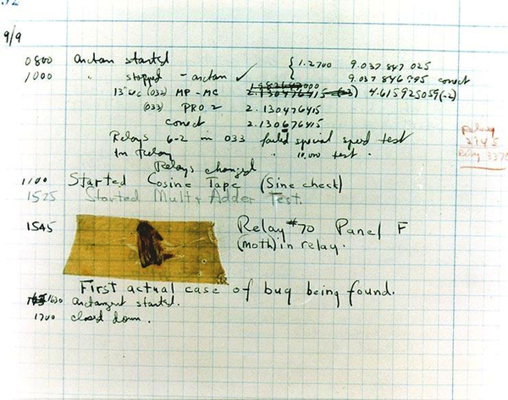
Testing and Debugging
Bug
A logical mistake in a program
Debugging
Eliminating mistakes in programs
Term used when a moth caused a failed relay on the Harvard Mark 11 computer. Grace Hopper and other programmers taped the moth in logbook stating:
“First actual case of a bug being found.”

Slide 4
Program Errors
Syntax errors
Violation of the grammar rules of the language
Discovered by the compiler
Error messages may not always show correct location of errors
Run-time errors
Error conditions detected by the computer at run-time
Logic errors
Errors in the program’s algorithm
Most difficult to diagnose
Computer does not recognize as an error

Slide 5
What makes a bad program?
Writing Code without detailed analysis and design
Repeating trial and error without understanding the problem
Debugging the program line by line, statement by statement
Writing tricky and dirty programs

Slide 6
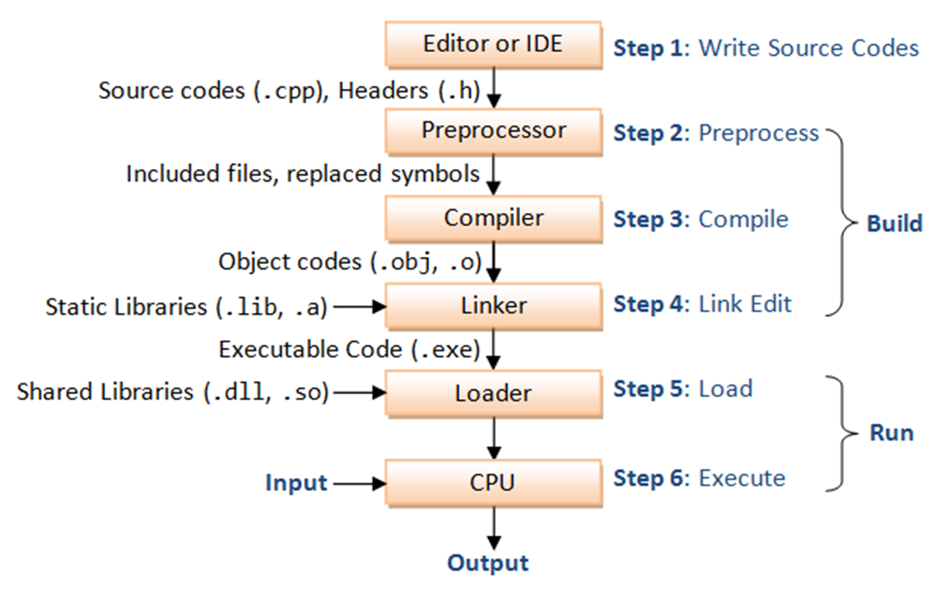
http://www.ntu.edu.sg/home/ehchua/programming/cpp/cp1_Basics.html
Notes:
http://www.ntu.edu.sg/home/ehchua/programming/cpp/cp1_Basics.html

Slide 7
Formatting Output
Manipulators
A manipulator functions format the output to present it in more readable fashion
For example
endl -- New line
cout << “Hello Dear…” << endl ;
setw(…) -- set width of output fields
cout << setw(10) << “Hello”<<“\t |1o characters width” << endl ;
setfill(…) -- specifies fill character
cout << setw(10) << setfill(‘*’) << “Hello”<<“\t |find difference in format of output” << endl ;
setprecision(…) -- specifies number of decimals for floating point : e.g. setprecision(2) ….

Slide 8
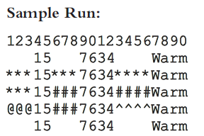
//Example setfile
#include <iostream>
#include <iomanip>
using namespace std;
int main()
{
int x = 15; //Line 1
int y = 7643 ; //Line 2
cout << "12345678901234567890" << endl; //Line 3
cout << setw(5) << x << setw(7) << y
<< setw(8) <<"Warm" << endl ; //Line 4
cout << setfill('*'); //Line 5
cout << setw(5) << x << setw(7) << y
<< setw(8) << "Warm" << endl ; //Line 6
cout << setw(5) << x << setw(7) << setfill('#')
<< y << setw(8) << "Warm" << endl ; //Line 7
cout << setw(5) << setfill('@') << x
<< setw(7) << setfill('#') << y
<< setw(8) << setfill('^') << "Warm"
<< endl ; //Line 8
cout << setfill(' ') ; //Line 9
cout << setw(5) << x << setw(7) << y
<< setw(8) << "Warm" << endl; //Line 10
return 0;
}

Slide 9
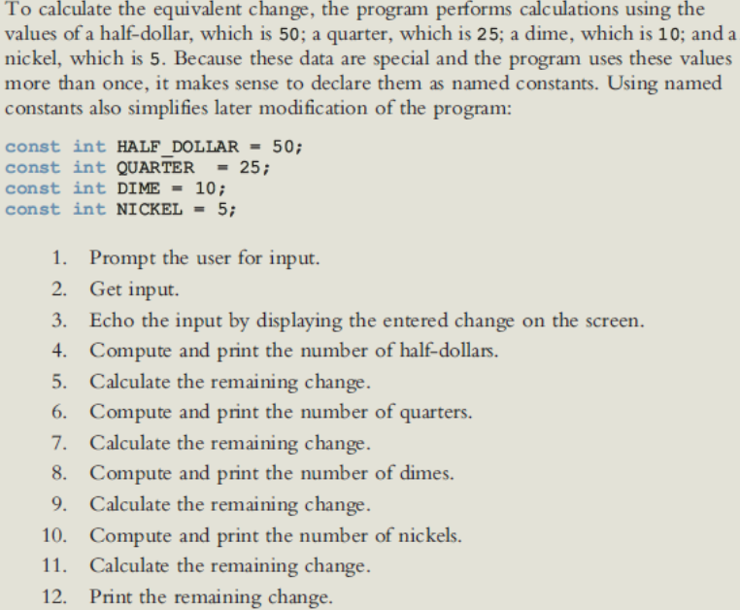

Slide 10
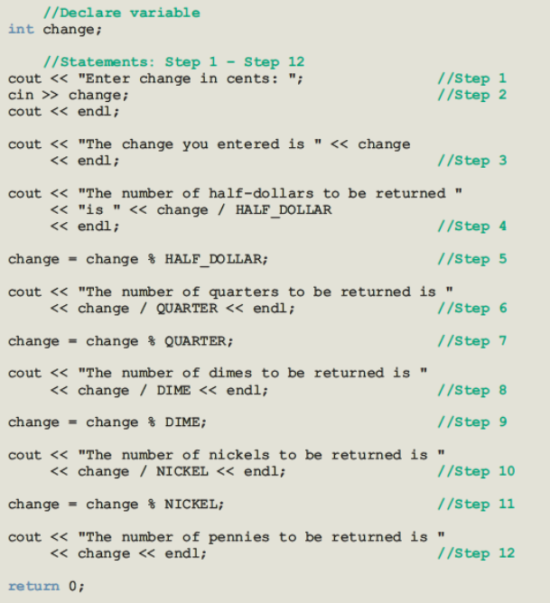

Slide 11
Fahrenheit to celsius
#include <iostream>
using namespace std;
int main()
{
int fahrenheit, celsius ;
cout << " Enter temperature in Fahrenheit : " ;
cin >> fahrenheit ;
cout << endl;
celsius = 5.0 / 9.0 * (fahrenheit - 32) ;
cout << fahrenheit << " degree F = "
<< celsius << " degree C" << endl;
return 0;
}

Slide 12
Objectives
In this lecture, you will:
Explore simple data types
Discover how to use arithmetic operators
Examine how a program evaluates arithmetic expressions
Learn what an assignment statement is and what it does
Become familiar with the string data type
Become familiar with the use of increment and decrement operators
Explore how to properly structure a program, including using comments to document a program
Learn how to write a C++ program

Slide 13

Data Types
Data type: Set of values together with a set of operations
C++ data types fall into three categories:

Slide 14
Simple Data Types
Three categories of simple data
Integral: integers (numbers without a decimal)
Floating-point: decimal numbers
Enumeration type: user-defined data type

Slide 15
Simple Data Types (cont'd.)
Integral data types are further classified into nine categories:
char, short, int, long, bool
unsigned char, unsigned short, unsigned int, unsigned long

Slide 16
Simple Data Types (cont'd.)
Different compilers may allow different ranges of values
Data Type | Values | Storage (in Bytes)
int | -2147483648 to 2147483647 | 4
bool | true and false | 1
char | -128 to 127 | 1

Slide 17
int Data Type
Examples:
-6728
0
78
+763
Positive integers do not need a + sign
No commas are used within an integer [76,385]
Commas are used for separating items in a list

Slide 18
bool Data Type
bool type
Two values: true and false
Manipulate logical (Boolean) expressions
true and false
Logical values
bool, true, and false
Reserved words

Slide 19
char Data Type
The smallest integral data type
Used for characters: letters, digits, and special symbols
Each character is enclosed in single quotes
'A', 'a', '0', '*', '+', '$', '&'
A blank space is a character
Written ' ', with a space left between the single quotes
‘abc’ and ‘!=‘ are not char

Slide 20
Floating-Point Data Types
You may be familiar with scientific notation. For example:
43872918 = 4.3872918 * 10⁷ {10 to the power of seven}
.0000265 = 2.65 * 10⁻⁵ {10 to the power of minus five}
47.9832 = 4.79832 * 10¹ {10 to the power of one}

Slide 21
Floating-Point Data Types
C++ uses scientific notation to represent real numbers (floating-point notation)
Real Number | C++ Floating-Point Notation
75.924 | 7.592400E1
0.18 | 1.800000E-1
0.0000453 | 4.530000E-5
-1.482 | -1.482000E0
7800.0 | 7.800000E3

Slide 22
Floating-Point Data Types (cont'd.)
float: represents any real number
Range: -3.4E+38 to 3.4E+38 (four bytes)
double: represents any real number
Range: -1.7E+308 to 1.7E+308 (eight bytes)

Slide 23
Floating-Point Data Types (cont'd.)
Maximum number of significant digits (decimal places) for float values is 6 or 7
Maximum number of significant digits for double is 15
Precision: Maximum number of significant digits
float values are called single precision
double values are called double precision

Slide 24
Data type and variables
When we declare a variable we not only specify the variable we also specify what type of data a variable can store. A syntax rule to declare a variable
datatype identifier;
For example consider the following examples:
int counter;
double interestRate;
char grade;

Slide 25
Datatypes and their ranges
Type | Width | Common Range
char | 8 | -128 to 127
unsigned char | 8 | 0 to 255
int | 32 | –2,147,483,648 to 2,147,483,647
unsigned int | 32 | 0 to 4,294,967,295
short int | 16 | -32768 to 32767
unsigned short int | 16 | 0 to 65535
long int | 64 | -2,147,483,648 to 2,147,483,647
unsigned long int | 64 | 0 to 4,294,967,295
float | 32 | 3.4E-38 to 3.4E+38
double | 64 | 1.7E-308 to 1.7E+308
long double | 80 | 3.4E-4932 to 3.4E+4932

Slide 26
Arithmetic Operators and Operator Precedence
C++ arithmetic operators:
+ addition
- subtraction
* multiplication
/ division
% modulus operator
+, -, *, and / can be used with integral and floating-point data types
Operators can be unary or binary

Slide 27
Example 2-3
Arithmetic Expression | Results | Description
5 / 2 | 2 | In the division 5 / 2, the quotient is 2 and the remainder is 1. Therefore, 5 / 2 with the integral operands evaluates to the quotient, which is 2.
14 / 7 | 2 | In the division 14 / 7, the quotient is 2 and remainder is 0. Therefore, 14 / 7 with integral operands evaluates to 2
34 % 5 | 4 | In the division 34 / 5, the quotient is 6 and the remainder is 4. Therefore, 34 %5 with the integral operands evaluates to the remainder, which is 4.
4 % 6 | 4 | In the division 4 / 6, the quotient is 0 and the remainder is 4. Therefore, 4 % 6 with the integral operands evaluates to the remainder, which is 4.

Slide 28
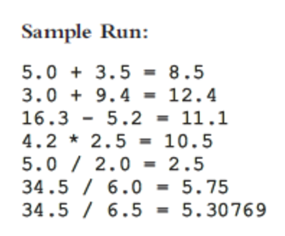
Example
#include <iostream>
using namespace std;
int main()
{
cout << "5.0 + 3.0 = " << 5.0 + 3.0 << endl;
cout << "3.0 + 9.4 = " << 3.0 + 9.4 << endl;
cout << "16.3 - 5.2 = " << 16.3 - 5.2 << endl;
cout << "4.2 * 2.5 = " << 4.2 * 2.5 << endl;
cout << "5.0 / 2.0 = " << 5.0 / 2.0 << endl;
cout << "34.5 / 6.0 = " << 34.5 / 6.0 << endl;
cout << "34.5 / 6.5 = " << 34.5 / 6.5 << endl;
return 0;
}

Slide 29
Example
Write a program that determine and output the equivalent length in feet and inches then convert inches into centimeters
(Hint: 12 inches in a feet , therefore 100 inches equal to 8 feet and 4 inches; 1 inch=2.54 centimeters)

Slide 30
C++ Math Operator Rules
* : Multiplication
/ : Division
Integer division truncates remainder
7 / 5 evaluates to 1
% : Modulus operator returns remainder
7 % 5 evaluates to 2
+ : Addition
- : Subtraction
Operator | Operation (s) | Order of evaluation (precedence)
() | Parentheses | Evaluated first. If the parentheses are nested, the expression in the innermost pair is evaluated first. If there are several pairs of parentheses “on the same level” (i.e., not nested), they are evaluated left to right.
*, / or % | Multiplication, Division, Modulus | Evaluated second. If there are several, they are evaluated left to right.
+ or - | Addition, Subtraction | Evaluated last. If there are several, they are evaluated left to right

Slide 31
Order of Precedence
All operations inside of () are evaluated first
*, /, and % are at the same level of precedence and are evaluated next
+ and – have the same level of precedence and are evaluated last
When operators are on the same level
Performed from left to right (associativity)
3 * 7 - 6 + 2 * 5 / 4 + 6 means
(((3 * 7) – 6) + ((2 * 5) / 4 )) + 6

Slide 32
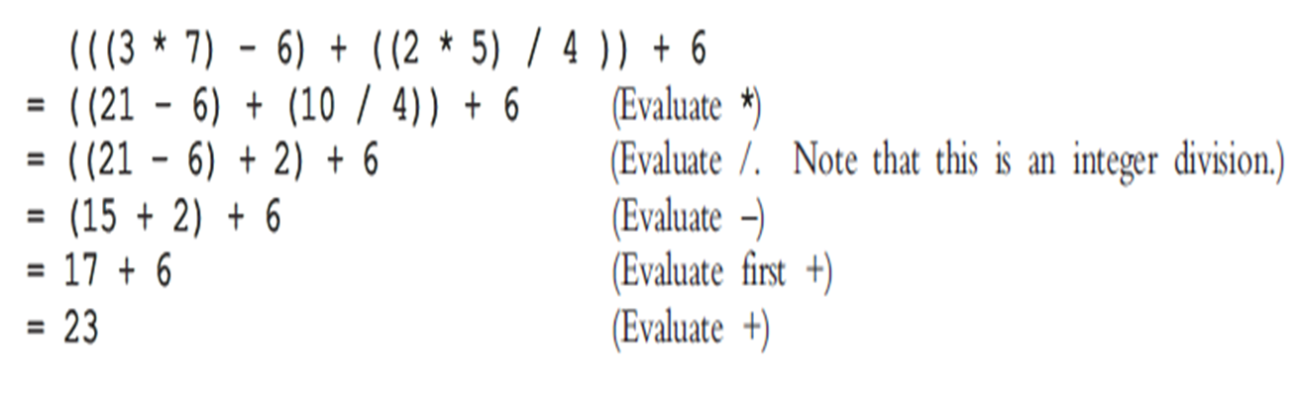
Example

Slide 33
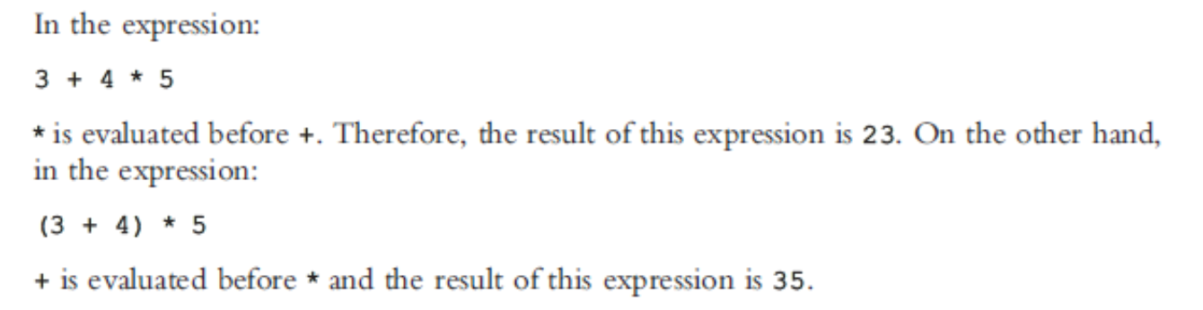
Example

Slide 34
Expressions
If all operands are integers
Expression is called an integral expression
Yields an integral result
Example: 2 + 3 * 5
If all operands are floating-point
Expression is called a floating-point expression
Yields a floating-point result
Example: 12.8 * 17.5 - 34.50

Slide 35
Examples
Consider the following C++ integral expressions:
2 + 3 * 5
3 + x - y / 7
x + 2 * (y - z) + 18
In these expressions, x, y, and z represent variables of the integer type; that is, they can hold integer values

Slide 36
Examples
Consider the following C++ floating-point expressions:
12.8 * 17.5 - 34.50
x * 10.5 + y - 16.2
Here, x and y represent variables of the floating-point type; that is, they can hold floating-point values

Slide 37
Mixed Expressions
Mixed expression:
Has operands of different data types
Contains integers and floating-point
Examples of mixed expressions:
2 + 3.5
6 / 4 + 3.9
5.4 * 2 – 13.6 + 18 / 2

Slide 38
Mixed Expressions (cont'd.)
Evaluation rules: Rule # 1
If operator has same types of operands
Evaluated according to the type of the operands
If operator has both types of operands
Integer is changed to floating-point with decimal part “0”
Operator is evaluated
Result is floating-point
Rule # 2
Entire expression is evaluated according to precedence rules

Slide 39
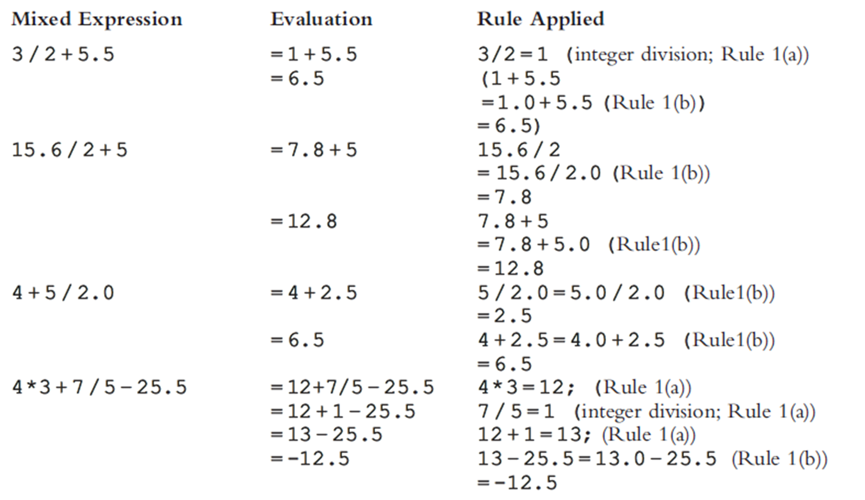
Examples

Slide 40
Solve this expression on notebook
10 * 5 + 100/10 – 5 + 7 % 2

Slide 41
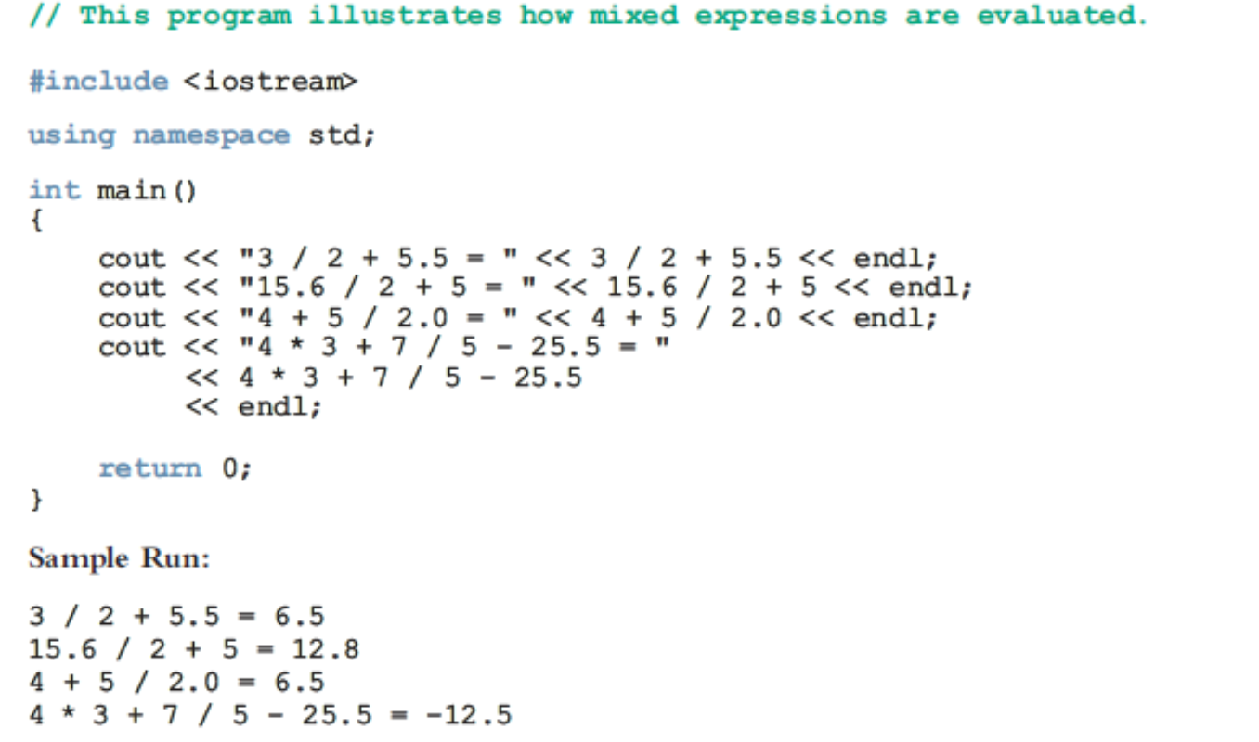
Example

Slide 42
Example (Integers)
2 + 5 = 7
13 + 89 = 102
34 - 20 = 14
45 - 90 = -45
2 * 7 = 14
5 / 2 = 2
14 / 7 = 2
34 % 5 = 4
4 % 6 = 4

Slide 43
Example (Float)
5.0 + 3.5 = 8.5
3.0 + 9.4 = 12.4
16.3 - 5.2 = 11.1
4.2 * 2.5 = 10.5
5.0 / 2.0 = 2.5
34.5 / 6.0 = 5.75
34.5 / 6.5 = 5.30769

Slide 44
Type Conversion (Casting)
Implicit type coercion: When value of one type is automatically changed to another type
2 + 3.4 = 2.0 + 3.4 = 5.4
int num1;
float num2 = 12.45;
num1 = num2;
num1 = ?
cast operator: provides explicit type conversion
static_cast<dataTypeName>(expression)

Slide 45
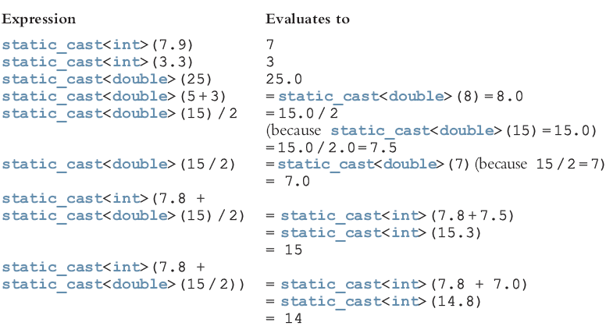
Type Conversion (cont'd.)

Slide 46
Type Conversion (cont'd.)
You can also use cast operators to explicitly convert
char data values into int data values
int data values into char data values
To convert char data values into int data values, you use a collating sequence
For example, in the ASCII character set
static_cast<int>('A') is 65 and static_cast<int>('8') is 56
Similarly, static_cast<char>(65) is 'A' and static_cast<char>(56) is '8'

Slide 47
Questions

